Slide 1
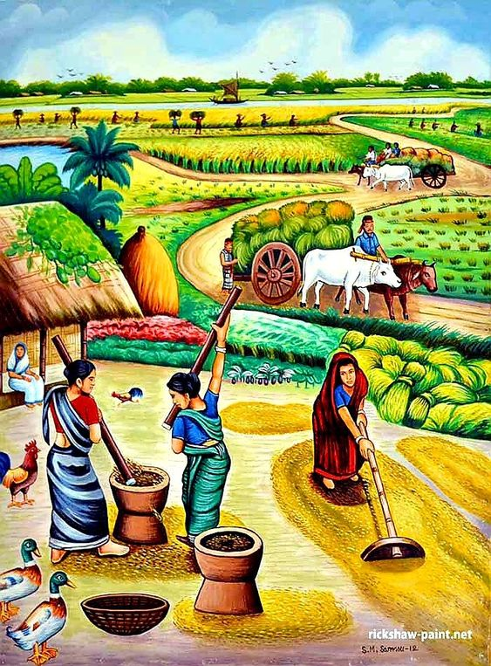

Tableau
Indian Agriculture Analysis
Batch MIP-DA-04

Slide 2
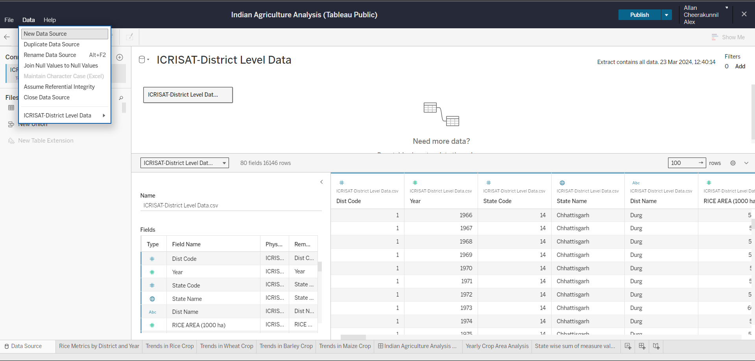
Data Source – ICRISAT-District Level Data

Slide 3
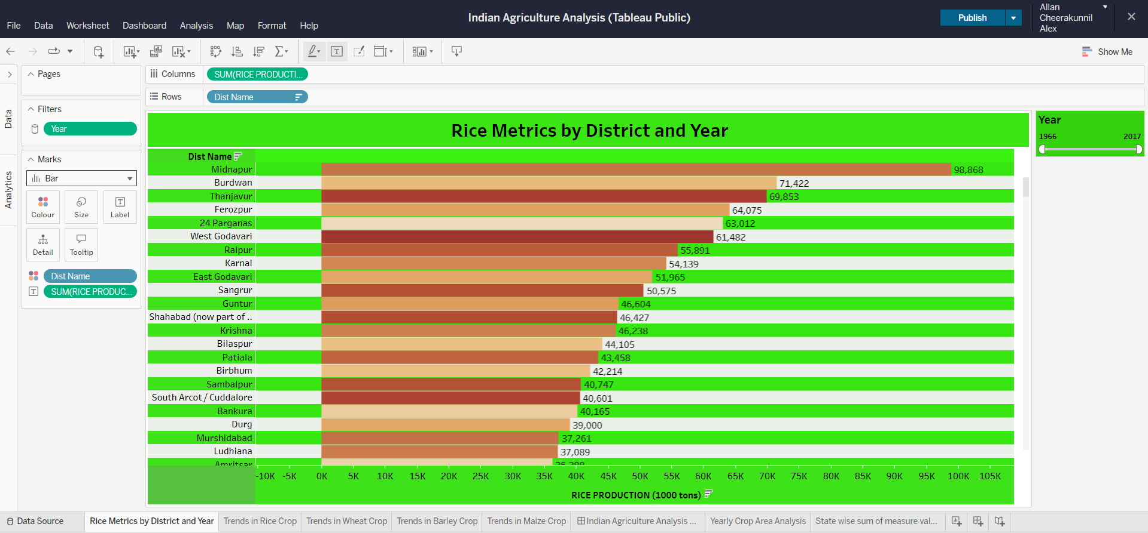
Rice metrics by District and Year

Slide 4
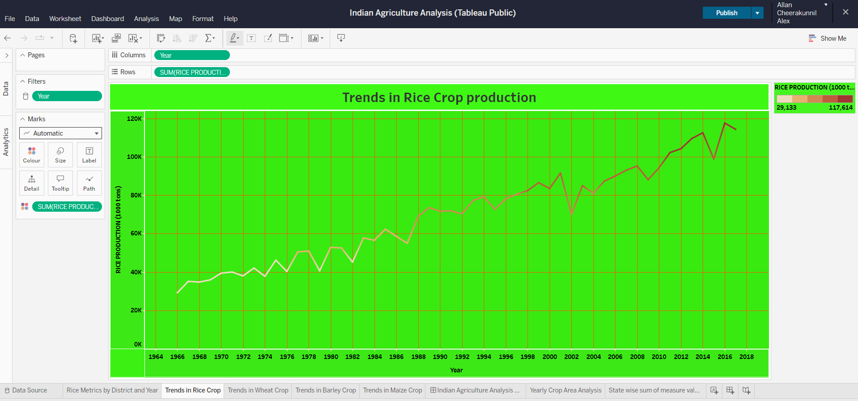
Using Line Graph – Trends in Rice Crop Production

Slide 5
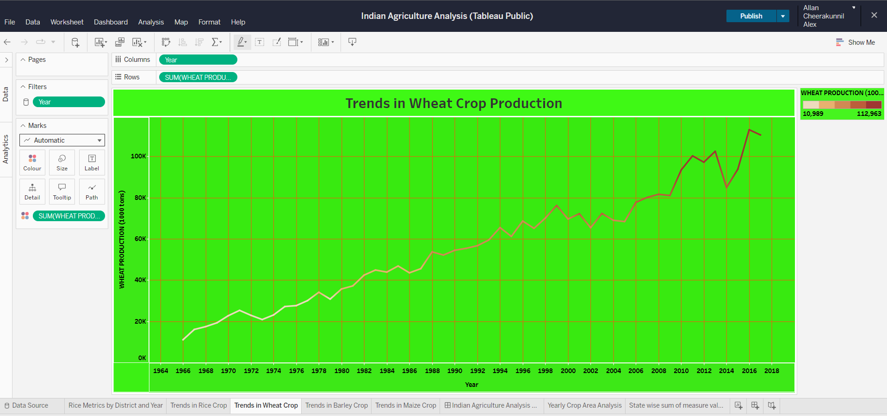
Trends in Wheat Crop Production

Slide 6
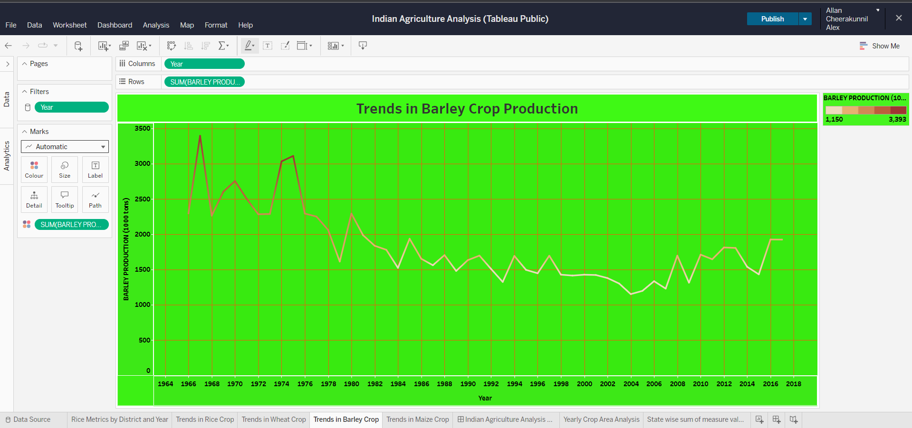
Trends in Barley Crop Production

Slide 7
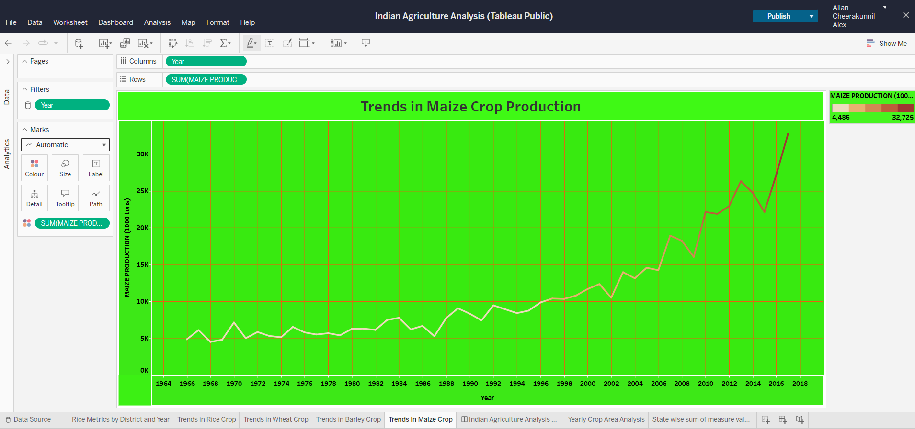
Trends in Maize Crop Production

Slide 8
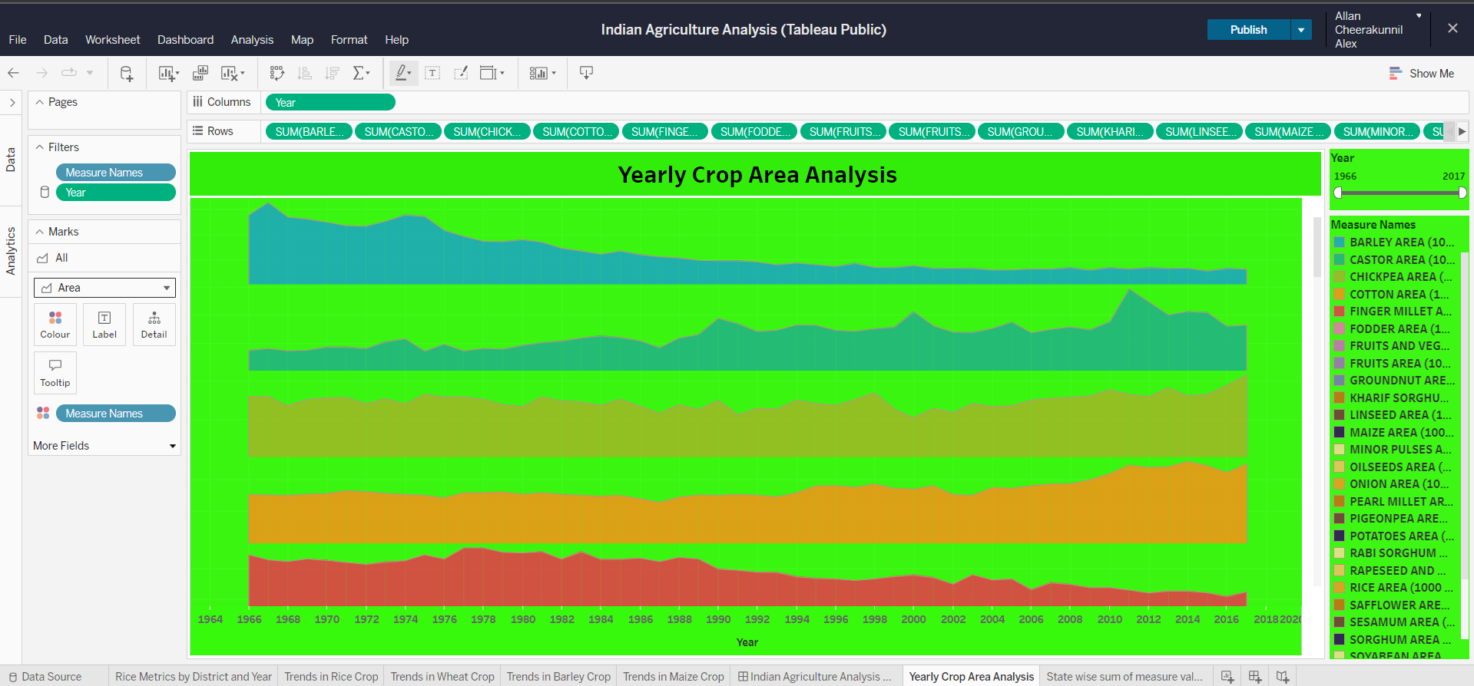
Yearly Crop Area Analysis

Slide 9
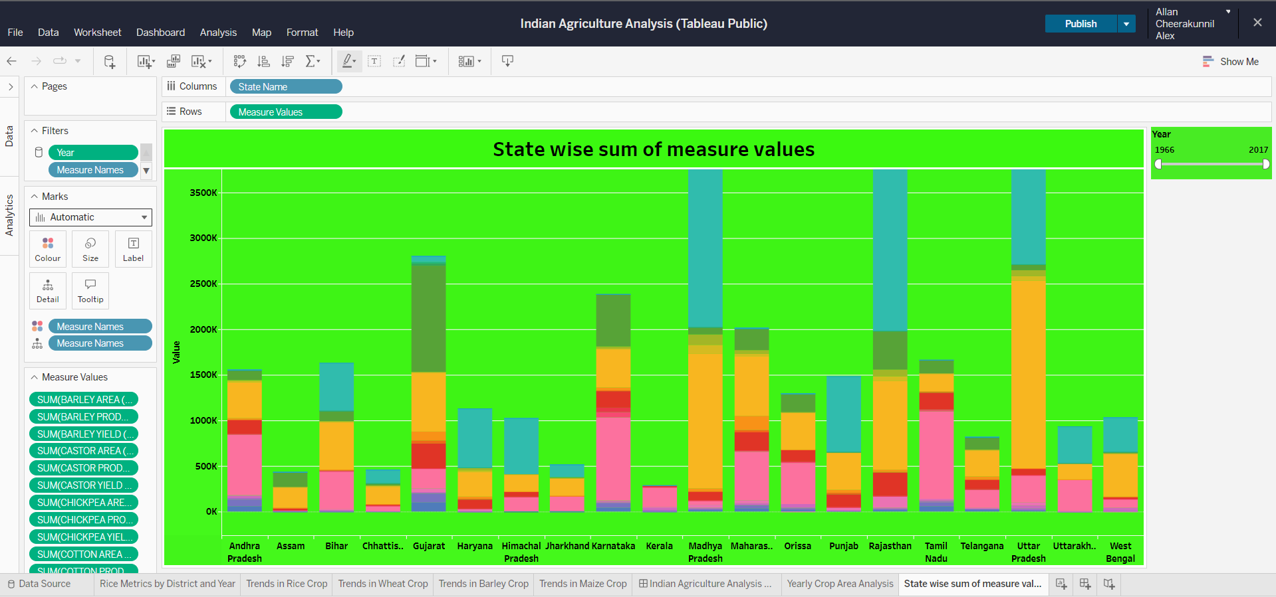
Yearly Crop Area Analysis

Slide 10
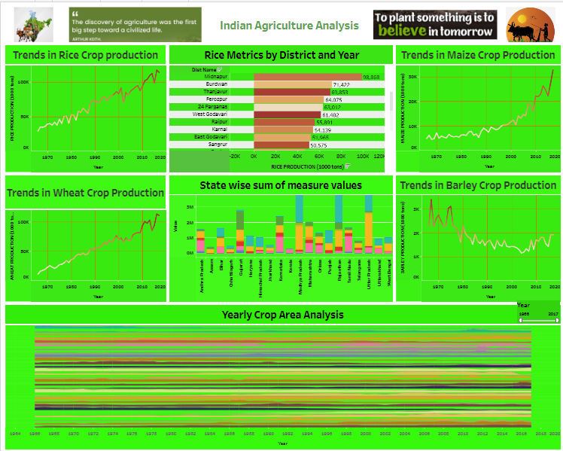
Dashboard – Indian Agriculture Analysis

Slide 11
Recommendations for policymakers and stakeholders in the agriculture sector
Investment in Infrastructure: Encourage policymakers to prioritize investments in rural infrastructure such as roads, irrigation facilities, storage facilities, and market linkages.
Technology Adoption: Promote the adoption of modern agricultural technologies such as precision farming, drones for crop monitoring, IoT devices for soil moisture management, and digital platforms for market information. This can lead to increased efficiency, better resource utilization, and improved decision-making for farmers.
Diversification and Crop Planning: Encourage farmers to diversify their crops based on agro-climatic zones and market demand. Provide support and incentives for crop planning strategies that promote sustainable practices, crop rotation, and the cultivation of high-value crops.
Water Management: Emphasize the importance of efficient water management practices such as drip irrigation, rainwater harvesting, and watershed management. Promote water-saving technologies and incentivize farmers to adopt practices that reduce water wastage and improve water-use efficiency.
Capacity Building and Training: Invest in training programs and capacity-building initiatives for farmers to enhance their skills in modern agricultural practices, financial management, and market awareness. Collaborate with agricultural universities, research institutions, and extension services to provide comprehensive training and extension services.

Slide 12
Thank You

